Slide 1

GROUP C
Presentation on chmod ommand in linux
Done by : R Shiva Kumar
Pavitra Naik

Slide 2
Chmod
Linux chmod command is used to change the access permissions of files and directories.
It stands for change mode. It can not change the permission of symbolic links. Even, it ignores the symbolic links come across recursive directory traversal.
In the Linux file system, each file is associated with a particular owner and have permission access for different users.
The user classes may be: owner
group member
others (Everybody else)

Slide 3
chmod Syntax: chmod <options> <mode> <file name>
Options:
-f, --silent, --quiet suppress most error messages
-v, --verbose output a diagnostic for every file processed
-R, --recursive change files and directories recursive
Modes: r(read) w(write) x(execute)

Slide 4
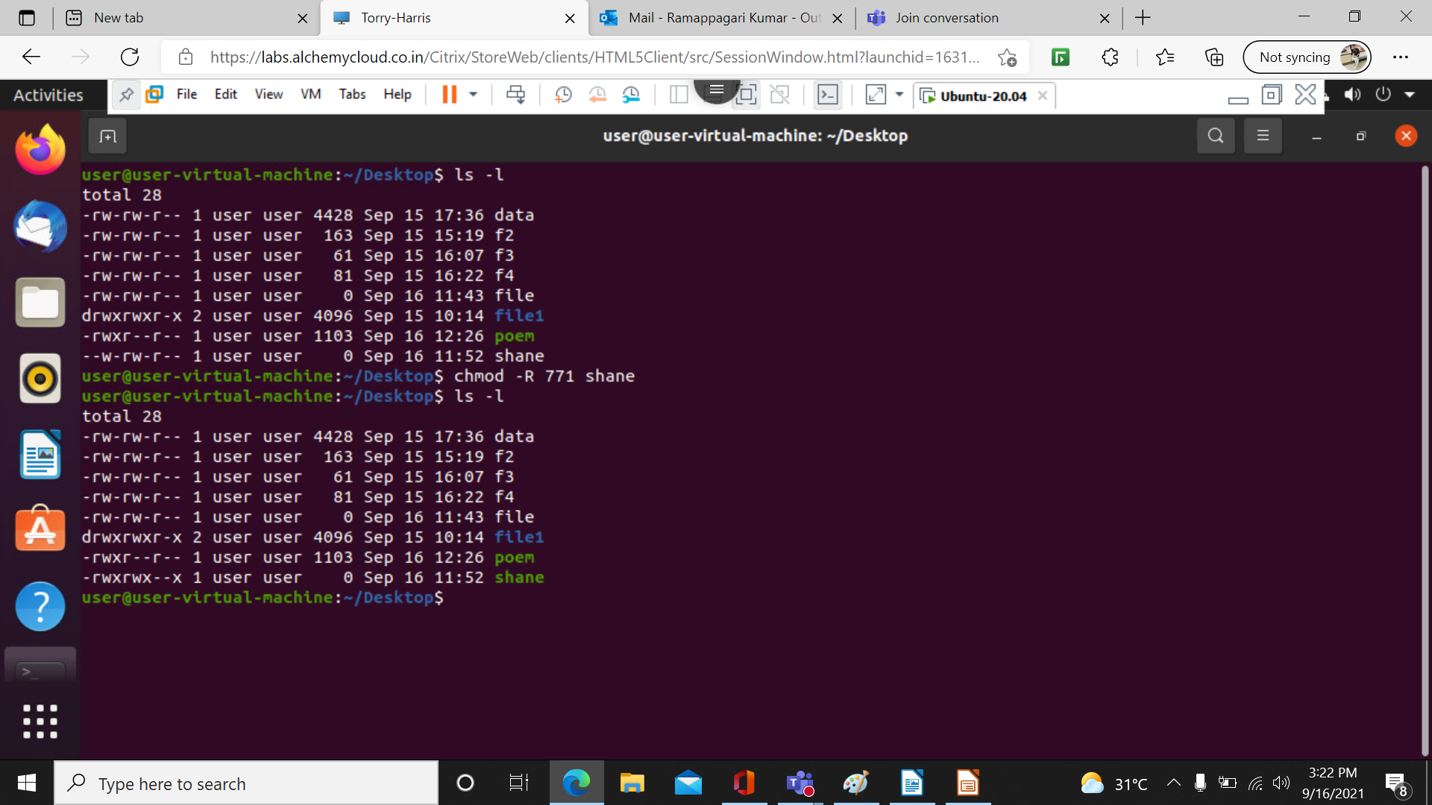
There are two ways in giving modes:
1. Octal owner group others r w x r w x r w x
4 2 1 4 2 1 4 2 1
Ex: chmod -R 771 file name

Slide 5

2. Symbolic:
Syntax: chmod references operator modes file references: u:owner of the file g:users who are member of file’s group o:users who are neither u nor g a: all ugo
Operator:
+: adds mode to specified classes
- : remove mode
=: exact mode to specified classes mode: r: read w: write x: execute eg: chmod u+x filename

Slide 6
THANK YOU

